Slide 1


CODEX MASTERCLASS

Slide 2
CODEX FOR DATA ANALYTICS

Slide 3

Project Overview
Sofia Martinez runs Lumen Pilates in two studios in Austin, she has months of messy CSV data and she wants to use Agentic AI capability to clean it up.
Scenario
What Sofia wants
Front desk software exports a flat CSV every quarter.
Dates are in three different formats, and naming conventions are inconsistent.
Same class spelled three different ways.
Members churn quietly. Time slots run half empty.
Sofia wants this in plain language:
Who is at risk of churning, so we can call them.
Which classes drive revenue.
Which time slots underperform.
Dashboard and one-page summary
© All rights reserved for Dr. Ryan Ahmed @Stemplicity Inc.

Slide 4
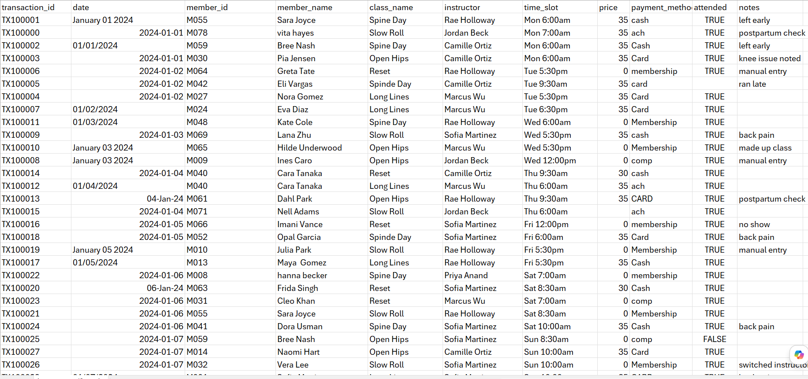
Dataset overview
© All rights reserved for Dr. Ryan Ahmed @Stemplicity Inc.

Slide 5
Project Steps
Codex has no built-in data skill. Anthropic already wrote one. Let’s borrow it!
1. Find the Skill
2. Read it
3. Adapt it
Anthropic publishes a public skills repo on GitHub. The data plugin sits inside.
Point Codex at the repo. Let it read the SKILL.md files and summarize what they do.
Install a local version scoped to Sofia's columns and the three questions she asked.
© All rights reserved for Dr. Ryan Ahmed @Stemplicity Inc.
data:explore-data
data:analyze
data:create-viz
data:statistical-analysis
@skill-creator will fetch the repo and create a skill file
.agents/skills/lumen-data/
Knows the Lumen schema
YAML frontmatter
Auto-discovered on launch

Slide 6
CLAUDE PLUGINS

Slide 7





Plugins
Plugins bundle skills, connectors, slash commands & sub-agents into one package for a specific job function. No technical knowledge required to create them.
What's Inside a Plugin
Pre-Built Plugins
Skills: Specialized knowledge & workflows
HR: People operations & lifecycle
Connectors (MCP): Link to Google Drive, Slack, etc.
Design: UX, accessibility, critiques
© All rights reserved for Dr. Ryan Ahmed @Stemplicity Inc.
Engineering: Standups, deploys, incidents
Slash Commands: Quick-launch structured workflows
Operations: Runbooks, vendor evals
Sub-Agents: Specialized task executors
Finance: FP&A, variance analysis
Sales: Outreach, research, CRM

Slide 8
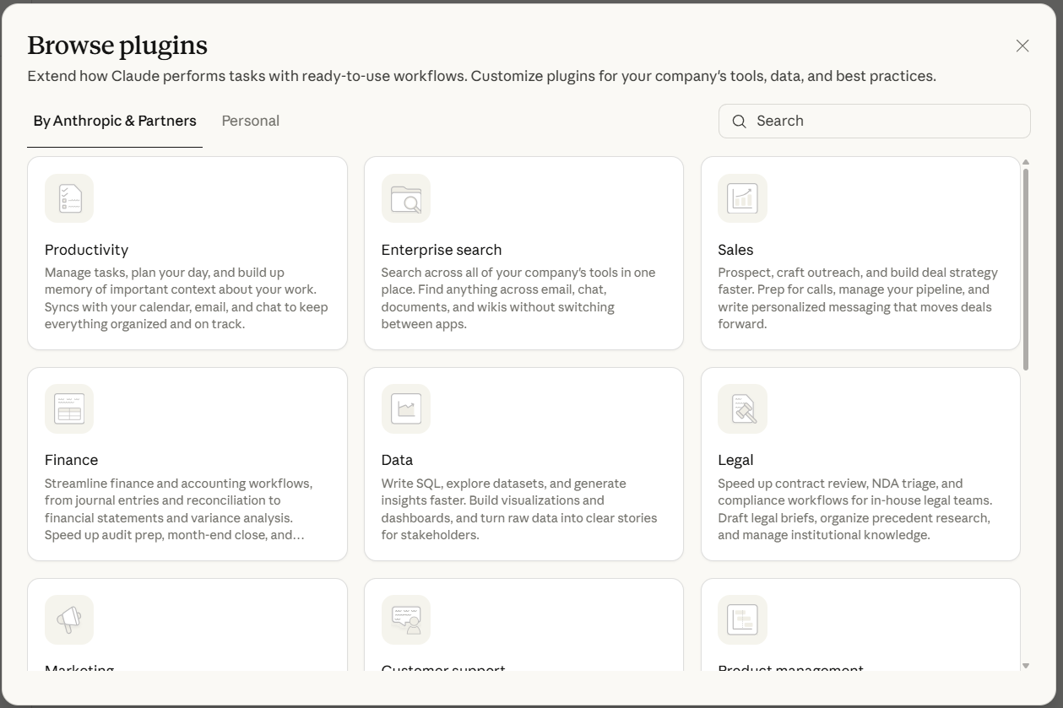
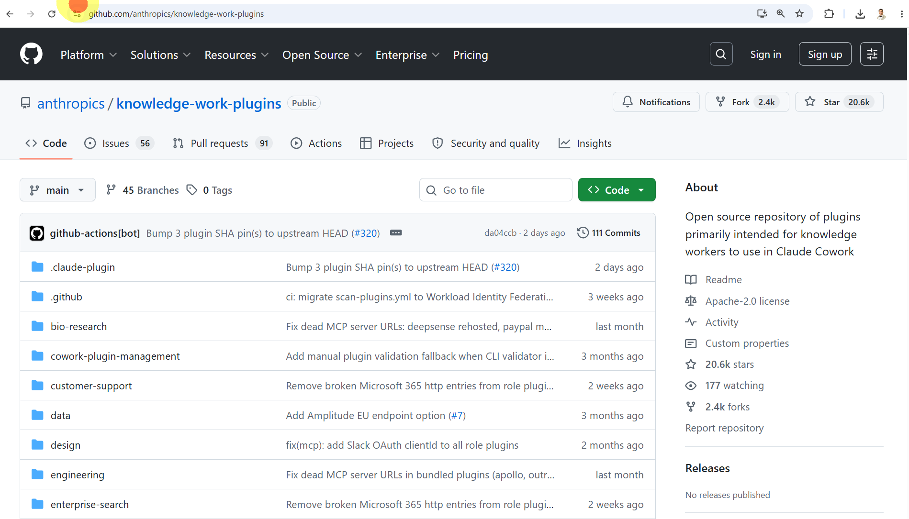
Available Claude Plugins
https://claude.com/plugins#plugins
https://github.com/anthropics/knowledge-work-plugins
© All rights reserved for Dr. Ryan Ahmed @Stemplicity Inc.

Slide 9
PRACTICE OPPORTUNITY

Slide 10

Practice Opportunity
Create a local Codex skill named @linkedin-post-coach by adapting this SkillHub example:
https://www.skillhub.club/skills/different-ai-zero-finance-linkedin-post
Then use @linkedin-post-coach to turn a rough idea into a polished LinkedIn post.
Tasks:
Use @skill-creator to create: .agents/skills/linkedin-post-coach/SKILL.md
Then use @linkedin-post-coach to create a LinkedIn post about the state of AI using the report attached.
Final output should include:
3 hook options
1 polished LinkedIn post
3 CTA options
5 hashtag suggestions
© All rights reserved for Dr. Ryan Ahmed @Stemplicity Inc.

Slide 11
Thank you!

